Slide 1

B. Tech. Project Mid-Semester Evaluation
Explainable Deep Learning Framework for Automated ECG Arrhythmia Detection and Classification
Presented by
Sidhesh Mahesh Tavare (2314037)
Nikhil Kumar Singh (2314055)
Supervisor
Dr. Arnab Nandi
Department of Electronics and Communication Engineering
National Institute of Technology Silchar
Notes:
Good morning respected panel members. We are Bhoomi Singhal (2314168) and Archita Roy (2314165), working under the supervision of Dr. Koushik Guha.
Our project is "Design of an Energy-Efficient EEG Seizure Detection System using Approximate Computing".
In one line: we detect epileptic seizures from EEG signals with a machine-learning classifier (SVM), and we plan to build its hardware with APPROXIMATE adders and multipliers so that it consumes much less power - making it suitable for wearable, battery-powered seizure monitors.

Slide 2
Introduction
Electrocardiogram (ECG)
Why automate?
Skin electrodes record the heart's electrical activity. Each beat shows a P wave, QRS complex and T wave; arrhythmias alter their morphology (shape) or rhythm (timing).
A 24 h Holter recording at ~70 bpm holds ≈ 100,000 beats. Manual beat-by-beat review is slow and error-prone, so automatic beat classification is needed.
What the framework must deliver
Accurate classification
Explanation
Robustness
per-class F1 on N, S, V, F
sample-level heatmap per beat
stable under real ECG noise
Deep models reach high accuracy but act as black boxes. This project pairs a CNN / CNN-LSTM classifier with Grad-CAM and SHAP, and quantitatively checks whether the explanations point at the clinically relevant waves.

Slide 3
ECG Beats & Arrhythmia Classes
P, QRS and T waves
RR interval
P = atrial depolarisation; QRS = ventricular depolarisation (normal width < 120 ms); T = ventricular repolarisation. Normal PR interval 120–200 ms.
Time between successive R peaks; heart rate = 60 / RR (s). A premature beat has a short previous RR and a long next RR (compensatory pause).
N – Normal {N, L, R, e, j}
S – Supraventricular {A, a, J, S}
Normal, bundle-branch-block and escape beats. ≈ 90% of all beats, so the data are heavily imbalanced.
Premature beats from the atria / AV junction. QRS is near-normal, so detection relies on the RR timing and an abnormal or hidden P wave.
V – Ventricular {V, E}
F – Fusion {F}
Ectopic focus in the ventricles: wide (≥ 120 ms), bizarre QRS, no preceding P wave, often an opposite-polarity T wave.
Normal and ventricular activation meet, giving an intermediate shape. Rarest class (< 1% of beats) and hardest to classify.
Labels are grouped into AAMI EC57 classes [12]; paced / unclassifiable beats (Q) are excluded, as in most MIT-BIH studies.

Slide 4
Literature Review & Research Gap
37 papers (2020–2026) on deep learning and XAI for ECG arrhythmia classification were reviewed.
Area
Existing direction & reported evidence
Deep learning models
CNN 96.8% vs CNN-LSTM 98.5% accuracy in a direct comparison [7]; lightweight CNN-LSTM with SHAP reports 98.24% over 9 rhythm classes [2]
Evaluation protocol
Only 30.3% of 122 studies use an inter-patient split [5]; where both are reported, F1 falls from 95.52% to 83.89% on unseen patients [4]
Explainability
Grad-CAM / SHAP mostly shown as example plots [2], [3]; < 10% of studies validate maps against P / QRS / T structures [6]
Research gap
Our project position
Explanations are rarely quantified: do they fall on the right wave, are they faithful to the model, and do they stay stable when the ECG is noisy?
Compare CNN vs CNN-LSTM + RR under intra- and inter-patient splits, then score Grad-CAM / SHAP with wave-region, deletion and noise-stability metrics.

Slide 5
Problem Statement & Motivation
Given a beat x ∈ ℝ²⁵² and its RR features r, learn a classifier f(x, r) → ŷ ∈ {N, S, V, F} together with an attribution map A(x) ∈ ℝ²⁵² that shows how much each sample drove the decision.
Black-box models
Class imbalance
Patient leakage
Noisy signals
Thousands of learned weights and no stated reason; a clinician cannot verify the decision.
N ≈ 90%, S ≈ 2%, F < 1% of beats: high accuracy can hide near-zero S / F recall.
Beats of one patient look alike; random splits place them in both train and test sets.
Muscle (EMG) and motion artefacts overlap the QRS band; most models are tested only on clean ECG.
Core pipeline: preprocess → classify → explain → validate
Motivation
• Long-term ECG screening needs automatic, beat-level arrhythmia detection.
• A heatmap a clinician can check (e.g. "wide QRS → V") builds trust in the prediction.
• Inter-patient and noise tests show how the model would behave on new, real recordings.

Slide 6
Project Objectives
01
Preprocess MIT-BIH
Band-pass filter, segment 252-sample beats around R peaks, compute normalised RR features, map labels to AAMI N / S / V / F.
Baseline & proposed
Train a 1D CNN baseline and a CNN-LSTM + RR model with class-weighted cross-entropy to handle the ≈ 45:1 N:S imbalance.
02
03
Fair evaluation
Intra-patient (stratified 80/20) and inter-patient DS1 → DS2 splits; confusion matrix, per-class precision, recall, F1, macro-F1.
04
Explain & validate
Grad-CAM and Gradient SHAP maps; measure importance share on P / QRS / T and faithfulness with a deletion test.
05
Robustness & demo
Add NSTDB muscle noise at 18 / 6 / 0 dB SNR: F1 vs SNR and heatmap stability; Streamlit demo of prediction + heatmap.

Slide 7
Dataset: MIT-BIH Arrhythmia Database
MIT-BIH Arrhythmia Database (PhysioNet)
Moody & Mark [1] • 48 records × 30 min • 47 subjects • 2 leads • 360 Hz, 11-bit • ≈ 110,000 annotated beats
Data used
Two evaluation splits
Lead MLII. Paced records 102, 104, 107, 217 removed → 44 records. Cardiologist beat labels and R-peak positions are used directly.
Intra-patient: stratified random 80/20 split of beats. Inter-patient [8]: train on DS1 (22 records), test on DS2 (22 other records).
Split | N | S | V | F | Total
DS1 (train) | 45,866 | 944 | 3,788 | 415 | 51,013
DS2 (test) | 44,259 | 1,837 | 3,221 | 388 | 49,705
AAMI beat counts per split [8]: S and F together are < 3% of beats, so per-class F1 matters more than accuracy.
Noise data: MIT-BIH Noise Stress Test Database (NSTDB) [11]
The 'ma' (muscle artefact) recording is scaled and added to test beats at SNR = 18, 6 and 0 dB, where SNR = 10·log₁₀(P_signal / P_noise).

Slide 8
Methodology
1
2
3
4
5
6
7
Raw ECG
→
Filter
→
Segment
→
RR
→
Classify
→
Predict
→
Explain
MLII, 360 Hz
BP 0.5–40 Hz
−0.25 / +0.45 s
prev, next
CNN / CNN-LSTM
N, S, V, F
Grad-CAM, SHAP
Steps 1–4 turn each record into fixed-length beats plus timing features; steps 5–7 classify each beat and produce a sample-level explanation.
Preprocessing
Features & training
• 4th-order zero-phase Butterworth band-pass, 0.5–40 Hz: removes baseline wander and 60 Hz mains
• Window: 90 samples before + 161 after the R peak = 252 samples (0.7 s)
• Per-beat z-score: x′ = (x − μ) / σ
• RR_prev, RR_next divided by the record's mean RR (removes patient heart-rate differences)
• Class-weighted cross-entropy, w_c = N / (K · n_c)
• Adam (lr 10⁻³), batch 128, early stopping on validation macro-F1

Slide 9
Models & Explainability
Beat x: 252 × 1
Baseline: 1D CNN (≈ 44 k parameters)
• Conv1D 32 (k=7) → 64 (k=5) → 128 (k=3)
• Each: BatchNorm → ReLU → MaxPool(2): 252 → 31 steps
• Global avg. pool → Dense 64 → Softmax 4
Conv1D ×3
32 → 64 → 128 ch
Heatmap
A(x) ∈ ℝ²⁵²
Grad-CAM / SHAP
Proposed: CNN-LSTM + RR
LSTM(64) (proposed only)
The 31 × 128 conv feature sequence feeds an LSTM(64) that models the P → QRS → T order; its last hidden state is concatenated with the 2 RR features before Dense 64 → Softmax 4.
Concat → Dense 64 → Softmax
RR prev, next
Explainability (Captum)
N / S / V / F
Grad-CAM [9]: α_k = (1/T) Σ_t ∂y_c / ∂A_k(t), L = ReLU(Σ_k α_k A_k), upsampled 31 → 252
Gradient SHAP [10]: averages gradient × (x − x′) over random baselines x′; Σ φ_i ≈ f(x) − E[f(x′)]
Expected: V beats → heatmap on the wide QRS; S beats → more weight on the P wave and RR inputs.

Slide 10
Evaluation & Explanation Metrics
Classification (per class)
Confusion matrix
Precision = TP / (TP + FP), Recall = TP / (TP + FN), F1 = 2PR / (P + R). Macro-F1 = mean F1 over N, S, V, F, so rare classes count equally.
4 × 4 table of true vs predicted class. Shows the typical errors: S beats called N (similar shape) and F beats called N or V.
Region share (are maps clinical?)
Deletion test (are maps faithful?)
R_w = Σ_{t∈w} |A(t)| / Σ_t |A(t)| for w ∈ {P, QRS, T}. Windows relative to R: P [−250, −80] ms, QRS [−50, +50] ms, T [+100, +400] ms.
Zero the 10% highest-importance samples: Δp = p_c(x) − p_c(x_del). Compare with 10% random samples; a faithful map gives a much larger drop.
Noise robustness
Explanation stability
Add NSTDB muscle noise at SNR ∈ {18, 6, 0} dB and plot macro-F1 vs SNR for both models.
ρ = Pearson correlation of A(x_clean) and A(x_noisy); ρ → 1 means the explanation does not change with noise.
All metrics are reported for both the intra-patient and inter-patient (DS1 → DS2) splits.

Slide 11
Work Done Till Mid-Semester
Completed
Development dataset [13]
• Literature review of 37 papers; research gap identified
• Framework, splits (incl. DS1 / DS2) and metrics defined
• V1: baseline 1D CNN, class-weighted loss, Grad-CAM
• V2: 5 step-by-step experiments + threshold tuning
• Final model: 98.41% accuracy, 91.10% macro-F1
Kaggle version of MIT-BIH, already segmented by the dataset authors: 187-sample beats (1.5 s at 125 Hz), scaled 0–1, five AAMI classes (N, S, V, F, Q).
Used to build and debug the training, evaluation and Grad-CAM pipeline before our own MIT-BIH preprocessing.
File | N | S | V | F | Q | Total
Train file | 72,471 | 2,223 | 5,788 | 641 | 6,431 | 87,554
Test file | 18,118 | 556 | 1,448 | 162 | 1,608 | 21,892
Train file split 80/20 (stratified, seed 42) → 70,043 train / 17,511 validation beats; the test file is used only for final scores.
Caveat: the split is by beat, so the same patients appear in training and test data (intra-patient). These scores are optimistic; DS1 / DS2 comes next.

Slide 12
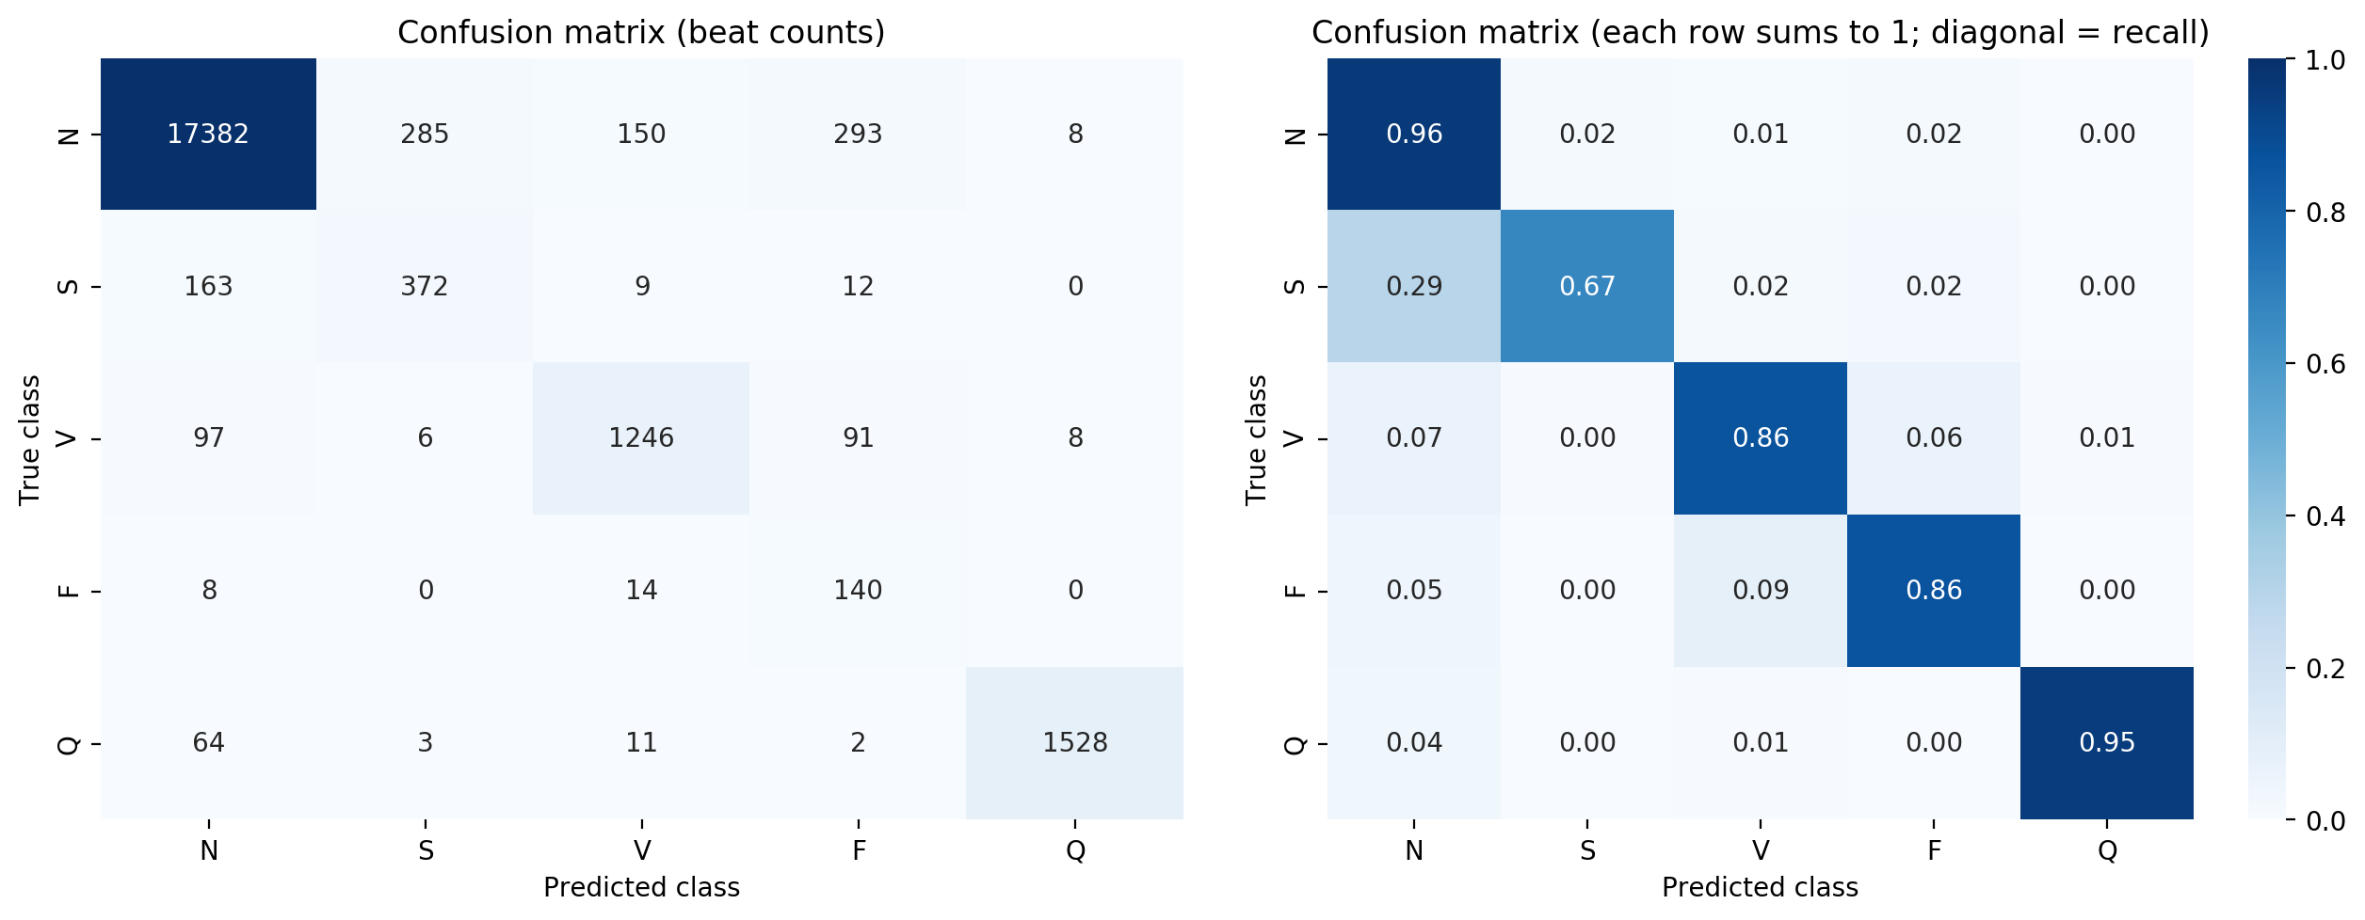
V1 Result: Baseline 1D CNN
Class | Precision | Recall | F1
N | 0.981 | 0.959 | 0.970
S | 0.559 | 0.669 | 0.609
V | 0.871 | 0.861 | 0.866
F | 0.260 | 0.864 | 0.400
Q | 0.990 | 0.950 | 0.970
Macro | 0.732 | 0.861 | 0.763
Accuracy 94.41% | Macro-F1 76.29%
• 538 beats predicted F, only 140 truly F (293 were N) → F precision 26%
• 29% of S beats called N (163 / 556)
• Validation accuracy swung 14.5% ↔ 95.1%; early stop at epoch 17 (best: 11)
• Cause: balanced weights make 1 F beat count as 113 N beats

Slide 13
V2: Step-by-Step Improvements
Same data, split and seed as V1. One change added per step; epoch, model and thresholds chosen on validation only.
ID | Change added | Acc. % | Macro-F1 % | S F1 % | F F1 % | Δ Macro-F1
B0 | V1 baseline | 94.41 | 76.29 | 60.90 | 40.00 | –
E1 | Best epoch by val. macro-F1 | 96.28 | 83.96 | 63.48 | 68.12 | +7.67
E2 | + LR 5e-4, clipping, BN mom. 0.9 | 93.58 | 78.30 | 49.13 | 58.49 | −5.66
E3 | + square-root class weights | 97.39 | 87.58 | 69.84 | 76.97 | +9.28
E4 | + light augmentation | 97.02 | 86.20 | 66.16 | 76.25 | −1.38
E5 | + residual CNN [14] (185 k params) | 98.29 | 90.77 | 81.22 | 78.53 | +4.57
Final | E5 + tuned thresholds (N × 3) | 98.41 | 91.10 | 82.14 | 79.23 | +0.33
What helped
What did not
• E1: picking the epoch on macro-F1, not val. loss
• E3: softer weights (F:N 113:1 → 10.6:1) – biggest gain, F precision 44 → 76%
• E5: residual network – smoothest training, S F1 66 → 81
• E2 stability settings: −5.66, swings remained
• E4 augmentation: −1.38
• Threshold tuning: only +0.33, trades S / F recall for precision
• Steps are cumulative, so E2 / E4 were kept in the final model

Slide 14
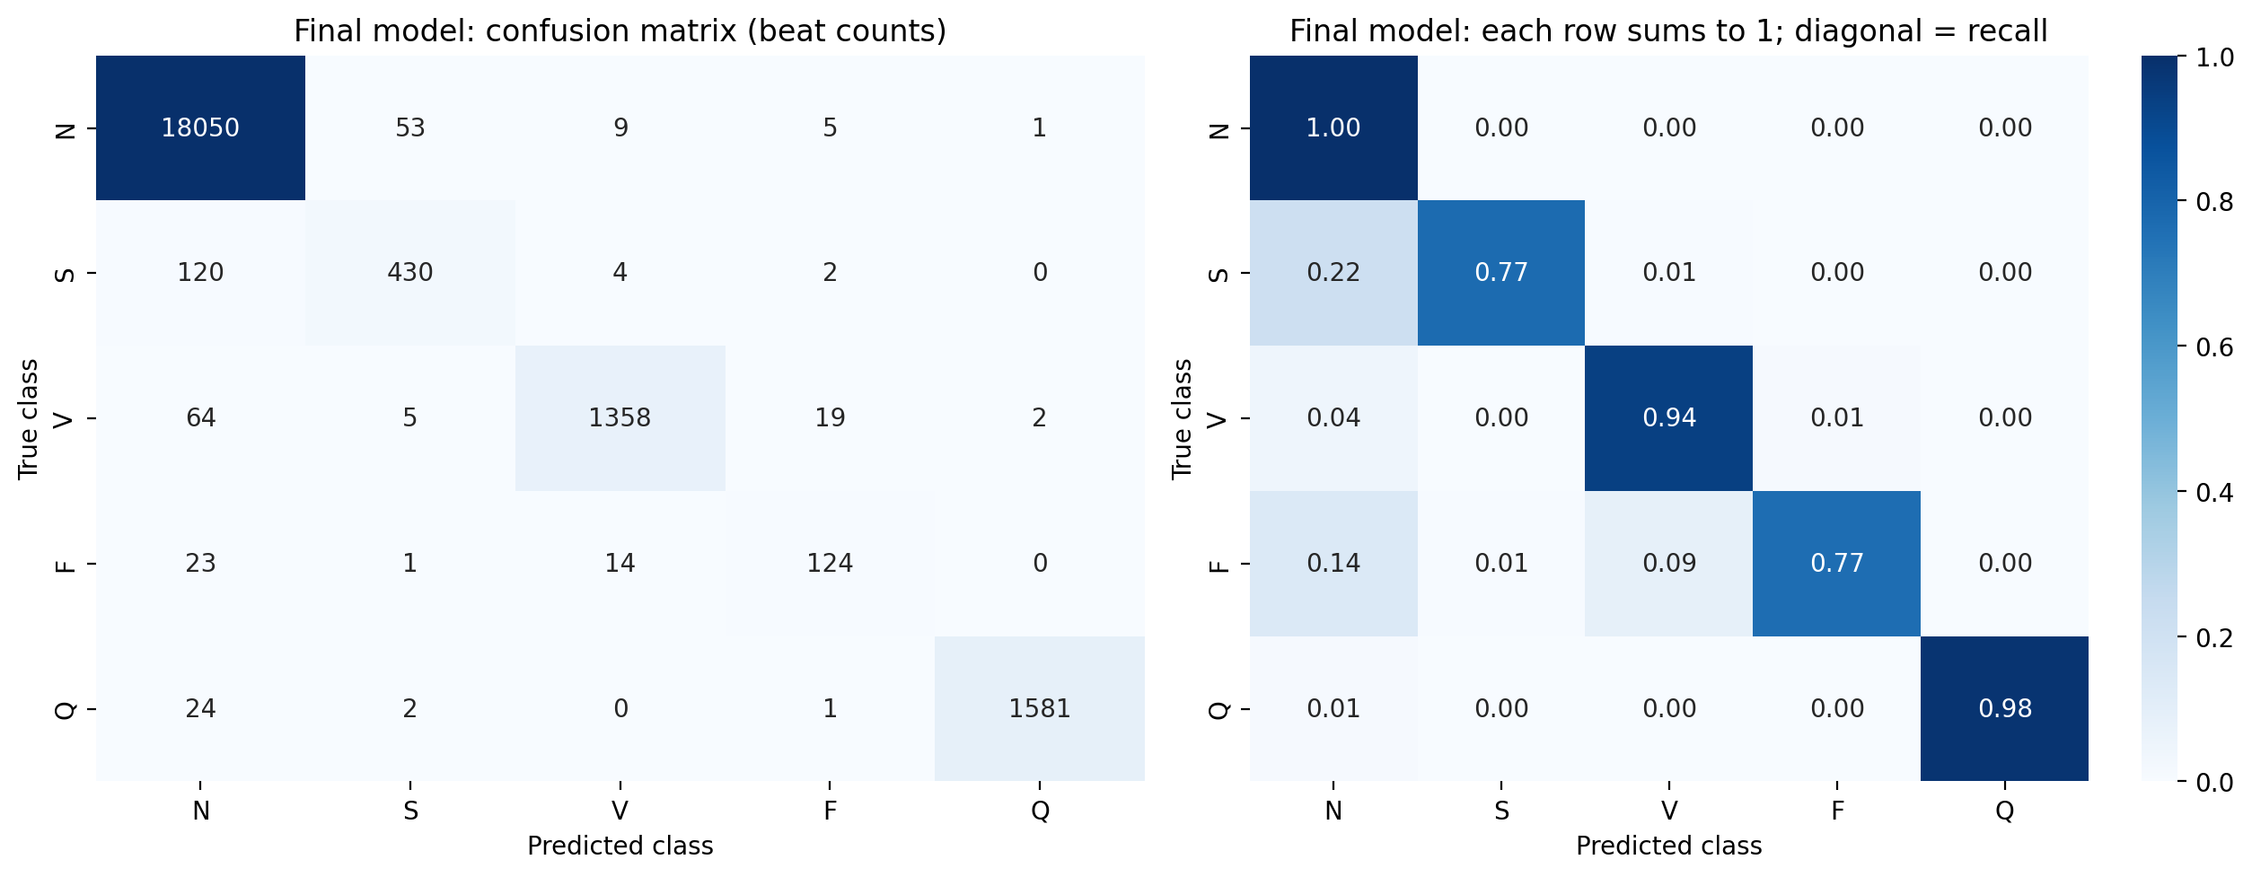
Final Model: Residual CNN + Tuned Thresholds
Class | Precision | Recall | F1
N | 0.987 | 0.996 | 0.992
S | 0.876 | 0.773 | 0.821
V | 0.981 | 0.938 | 0.959
F | 0.821 | 0.765 | 0.792
Q | 0.998 | 0.983 | 0.991
Macro | 0.933 | 0.891 | 0.911
Metric (%) | V1 (B0) | Final
Accuracy | 94.41 | 98.41
Macro-F1 | 76.29 | 91.10
Precision S | 55.86 | 87.58
Precision F | 26.02 | 82.12
Recall S | 66.91 | 77.34
Recall F | 86.42 | 76.54
Largest remaining error: S → N (120 of 556 S beats). S differs from N mainly in timing, which motivates the RR features. F recall fell because V1's high recall came from over-predicting F.

Slide 15
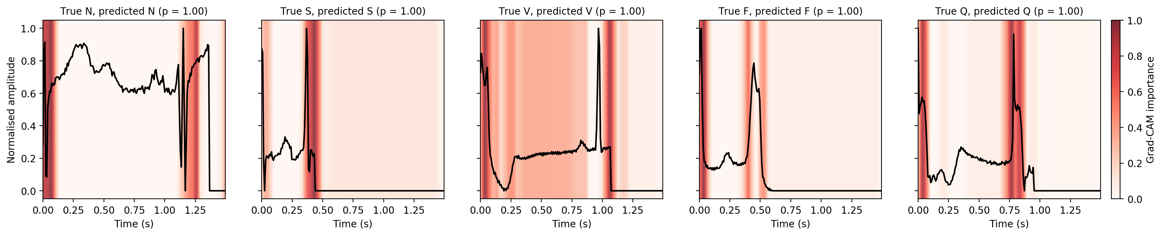
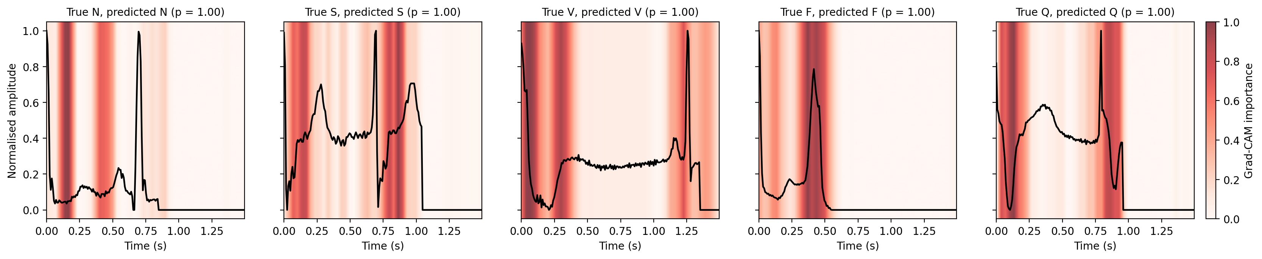
Grad-CAM Explanations
V1 baseline CNN
Final model (residual CNN)
• Most confident correct test beat per class; red = regions that drove the prediction.
• Heat concentrates at the window start and around the second R peak → the model likely uses the timing of the next beat (an implicit RR cue), not only beat shape. Final-model maps are broader.
• Qualitative only so far → next: P / QRS / T region share and deletion test, plus SHAP.

Slide 16
Challenges & Lessons Learned
Class imbalance
Unstable training
Balanced weights (F:N 113:1) made the model over-predict F: precision 26%. Square-root weights (10.6:1) fixed most of it.
Validation accuracy swung 14.5% ↔ 95.1%; early stopping on validation loss stopped too early. Selecting on macro-F1 and a residual CNN helped.
Not every change helps
Optimistic setting
Stability settings (E2) and augmentation (E4) lowered macro-F1. Steps were cumulative, so the best combination is not yet known.
Pre-segmented Kaggle beats, intra-patient split, 5 classes, single seed. Next: raw MIT-BIH, 4 classes, RR features and DS1 / DS2.

Slide 17
Conclusion And Future Scope
Key takeaways
• A working pipeline is in place: training, macro-F1-based evaluation and Grad-CAM.
• Macro-F1 76.29% → 91.10% (accuracy 94.41% → 98.41%) via epoch selection, softer class weights and a residual CNN.
• S → N remains the main error; results are intra-patient, so inter-patient scores will be lower.
• Published 98–99% accuracies are mostly intra-patient; our framework adds region, deletion and noise-stability scores.
Next steps
Raw MIT-BIH preprocessing (4 classes, RR features) → CNN vs CNN-LSTM + RR → DS1 / DS2 evaluation → Grad-CAM / SHAP with region and deletion checks → NSTDB noise tests → Streamlit demo.
Future scope
External test on INCART, automatic R-peak detection (Pan-Tompkins), MC-dropout uncertainty, full P/QRS/T delineation and clinician review of explanations.

Slide 18
References
[1] G. B. Moody and R. G. Mark, “The impact of the MIT-BIH Arrhythmia Database,” IEEE Eng. Med. Biol. Mag., vol. 20, no. 3, pp. 45–50, 2001.
[2] N. Alamatsaz et al., “A lightweight hybrid CNN-LSTM explainable model for ECG-based arrhythmia detection,” Biomed. Signal Process. Control, vol. 90, 2024.
[3] D. Tenepalli and T. M. Navamani, “Design of an explainable deep learning framework for ECG-based arrhythmia prediction,” IEEE Access, vol. 13, 2025.
[4] Q. Xiao et al., “Deep learning-based ECG arrhythmia classification: A systematic review,” Applied Sciences, vol. 13, 4964, 2023.
[5] G. A. L. Silva et al., “A systematic review of ECG arrhythmia classification: Adherence to standards, fair evaluation, and embedded feasibility,” arXiv:2503.07276, 2025.
[6] N. N. Kulkarni et al., “Recent advances in deep learning based arrhythmia classification using ECG and PPG signals: a systematic review,” Discover Computing, vol. 29, 2026.
[7] P. Pramkeaw et al., “Deep learning-based ECG arrhythmia detection system: A comparative study of CNN, RNN, and LSTM architectures,” IEEE ICCI, 2026.
[8] P. de Chazal, M. O’Dwyer and R. B. Reilly, “Automatic classification of heartbeats using ECG morphology and heartbeat interval features,” IEEE Trans. Biomed. Eng., vol. 51, no. 7, 2004.
[9] R. R. Selvaraju et al., “Grad-CAM: Visual explanations from deep networks via gradient-based localization,” Proc. IEEE ICCV, 2017.
[10] S. M. Lundberg and S.-I. Lee, “A unified approach to interpreting model predictions,” Proc. NeurIPS, 2017.
[11] G. B. Moody, W. Muldrow and R. G. Mark, “A noise stress test for arrhythmia detectors,” Computers in Cardiology, vol. 11, 1984.
[12] ANSI/AAMI EC57, “Testing and reporting performance results of cardiac rhythm and ST segment measurement algorithms,” AAMI, 2012.
[13] M. Kachuee, S. Fazeli and M. Sarrafzadeh, “ECG heartbeat classification: A deep transferable representation,” Proc. IEEE ICHI, pp. 443–444, 2018.
[14] K. He, X. Zhang, S. Ren and J. Sun, “Deep residual learning for image recognition,” Proc. IEEE CVPR, pp. 770–778, 2016.

